Slide 1
Global citizenship
Céin O’Rourke

Slide 2

What is it?
Becoming one nation
Equality/Understanding
Respect
Coming together

Slide 3
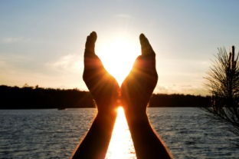
Pro’s
Endless opportunities
More visionaries/Less fear
Brighter future

Slide 4
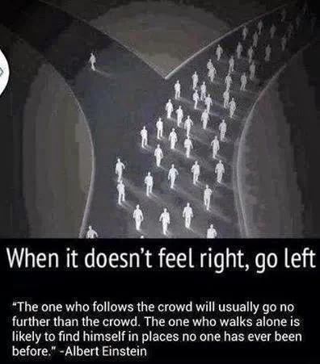

Slide 5


Slide 6
Con’s
Failure
Corruption
Greed
Restrictions

Slide 7

Technology

Slide 8

Pro’s
Connecting
Information
Inventions

Slide 9

Con’s
Anti-Social
Catfishes
Hacking

Slide 10


